Slide 1
The Back
山东大学医学院 解剖教研室
李振华

Slide 2
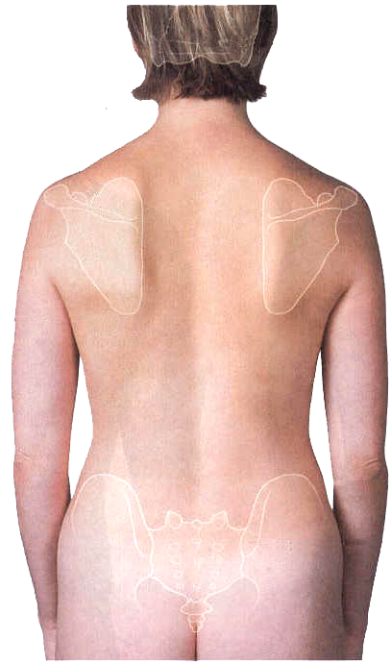
The Back
Boundaries
  Superior: external occipital protuberance and superior nuchal line
  Inferior: line from the coccyx apex to posterior superior iliac spine
  Lateral: anterior border of trapezius, posterior border of deltoid, posterior axillary line
Divisions
  Nape region
  Back region
  Lumbar region
  Sacrococcygeal region

Slide 3
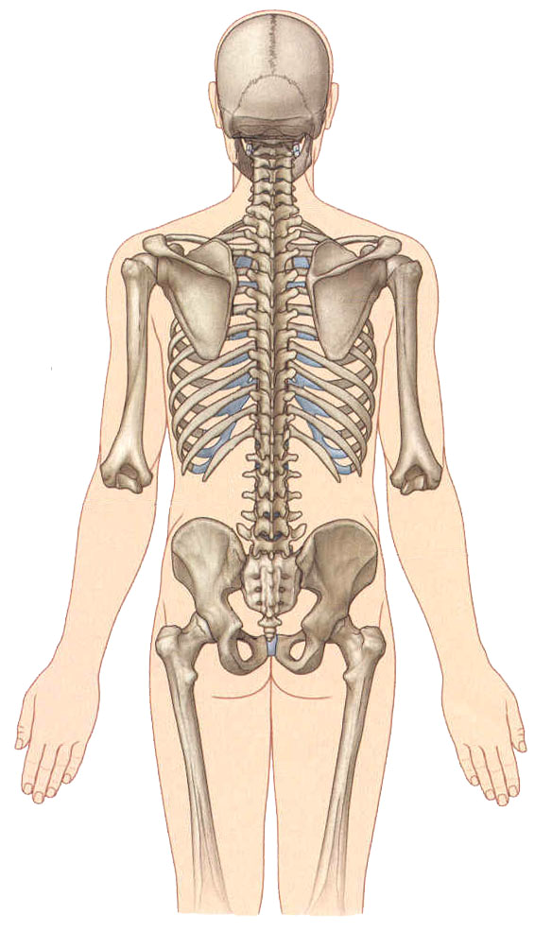
The Back
Surface Anatomy
Spinous process 棘突
Sacral cornu 骶角
Sacral hiatus 骶管裂孔
Coccyx 尾骨
Iliac crest 髂嵴
Posterior iliac spine 髂后上棘
Spine of scapula 肩胛冈
Acromion 肩峰
Inferior angle of scapula 肩胛骨下角
12th rib 第12肋
Erector spinae 竖脊肌
Vertebrocostal angle 脊肋角

Slide 4
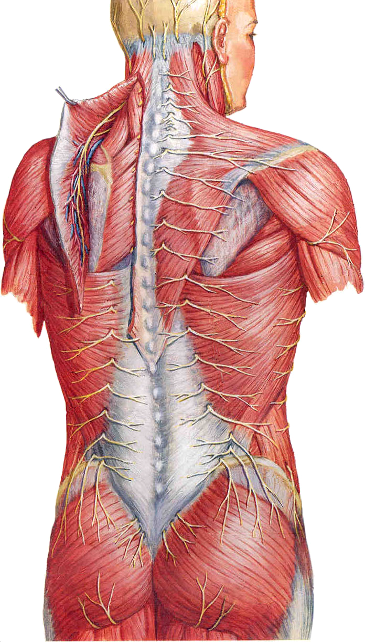
The Back
Layers and Structures
Skin
  thicker, less movable
  abundant of hair sac and sebaceous glands
Superficial fascia
  Greater occipital nerve 枕大神经
  Third occipital nerve 第3枕神经
  Superior cluneal nerves 臀上皮神经
  Middle cluneal nerves 臀中皮神经
Deep fascia
  Nuchal fascia 项筋膜
  Thoracolumbar fascia 胸腰筋膜

Slide 5
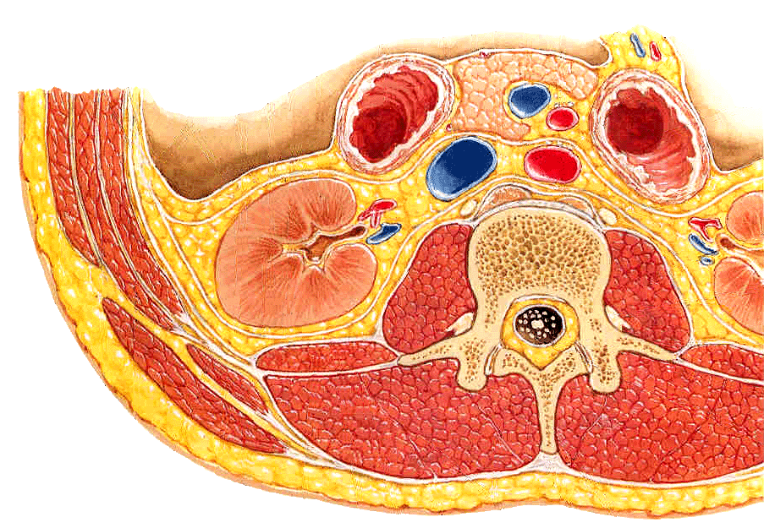
Thoracolumbar Fascia 胸腰筋膜
Anterior layer
Middle layer
Posterior layer

Slide 6
Muscles of The Back
Superficial muscle group
Trapezius 斜方肌
Latissimus dorsi 背阔肌

Slide 7
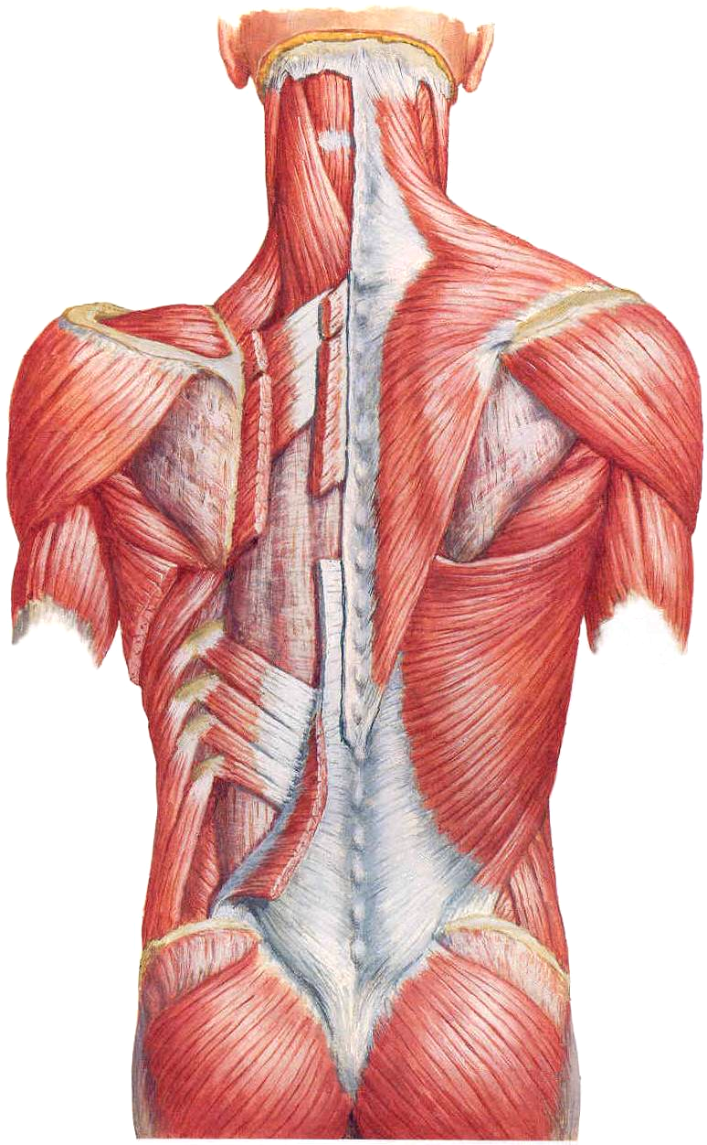
Muscles of The Back
Intermediate muscle group
Levator scapular 肩胛提肌
Rhomboideus 菱形肌
Serratus posterior superior 上后锯肌
Serratus posterior inferior 下后锯肌

Slide 8
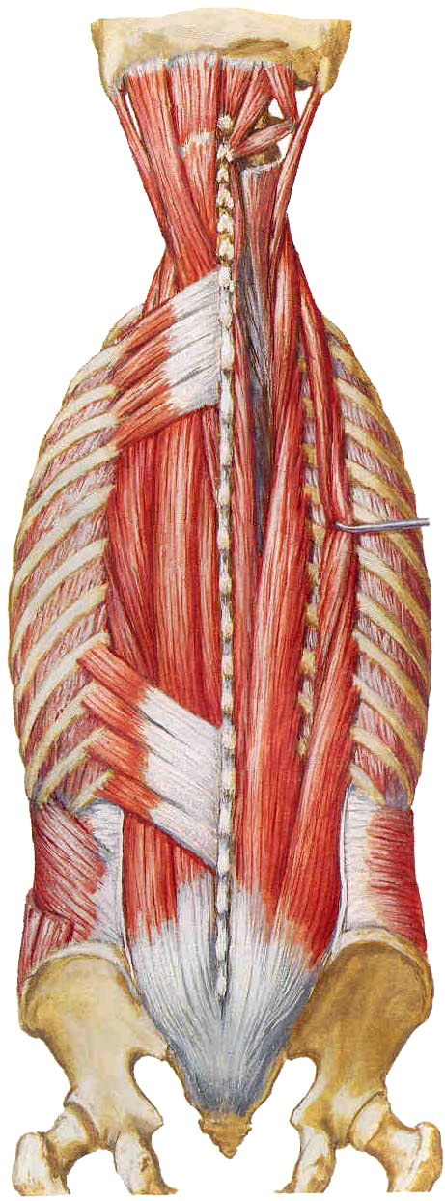
Muscles of The Back
Deep muscle group
Semispinalis capitis 头半棘肌
Splenius capitis 头夹肌
Splenius cervicis 颈夹肌
Erector spinae 竖脊肌
  Iliocostalis 髂肋肌
  Longissimus 最长肌
  Spinalis 棘肌

Slide 9
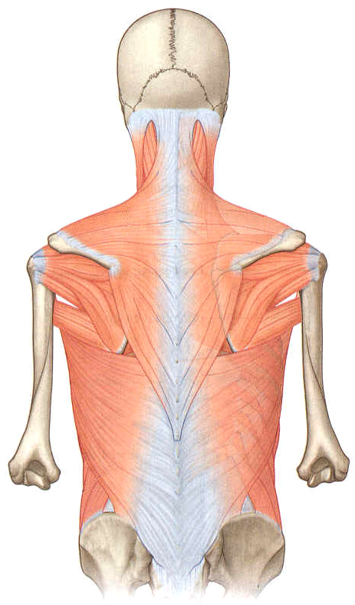
Triangles of the Back
Triangle of auscultation 听诊三角
Boundaries
  Latissimus dorsi
  Trapezius
  Medial border of the scapula
Clinical correlation
  Here, ribs 6 and 7 and the intercostal space 6 are free of overlying muscles.
  Thus, this area is particularly suited for auscultation.

Slide 10
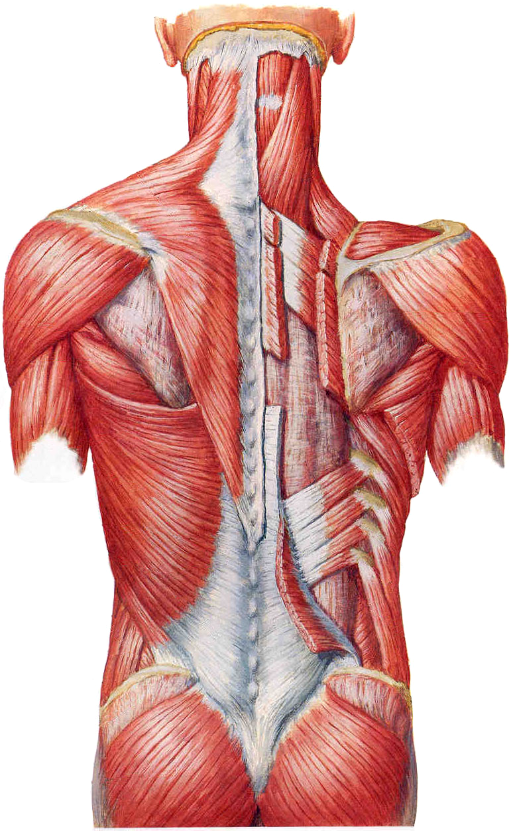
Triangles of the Back
Inferior lumbar triangle 腰下三角
Boundaries
  Lower part of the lateral margin of latissimus dorsi
  Posterior free border of the obliquus externus abdominis
  Iliac crest
  Floor: obliquus internus abdominis
Clinical correlation
  On rare occasions, this weak triangular space is the site of a “lumbar hernia”

Slide 11
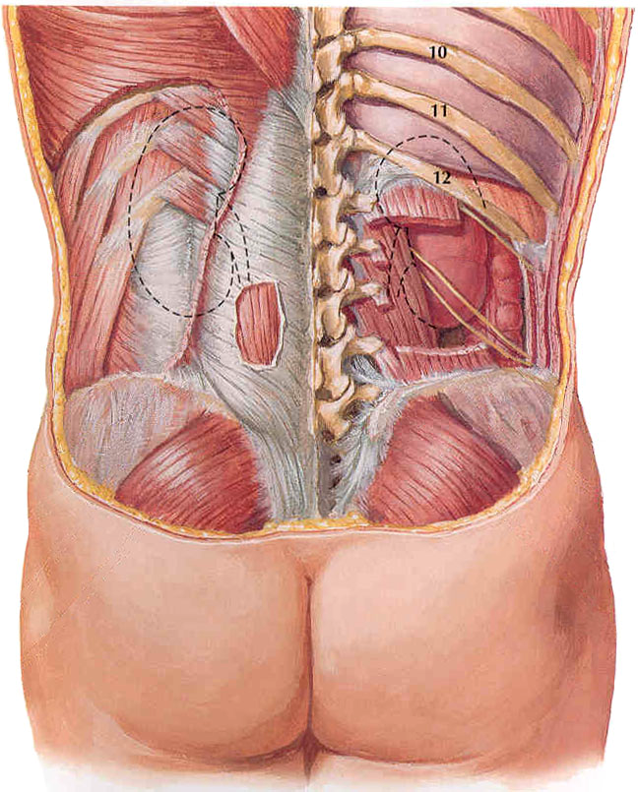
Triangles of the Back
Superior lumber triangle 腰上三角
Boundaries
  Erector spinae
  Serratus posterior inferior
  Obliquus internus abdominis
  Floor: aponeurosis of transverses abdominis
Clinical correlation
  It is crossed by the subcostal, iliohypogastric and the ilioinguinal nerves

Slide 12
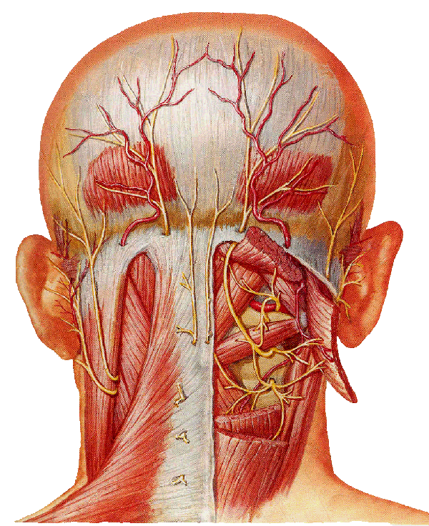
Triangles of the Back
Suboccipital Triangle 枕下三角
Boundaries
  Rectus capitis posterior major
  Obliquus capitis inferior
  Obliquus capitis superior
  Floor: posterior atlantooccipital membrane, posterior arch of the atlas
Contents
  vertebral a.
  Suboccipital n.

Slide 13
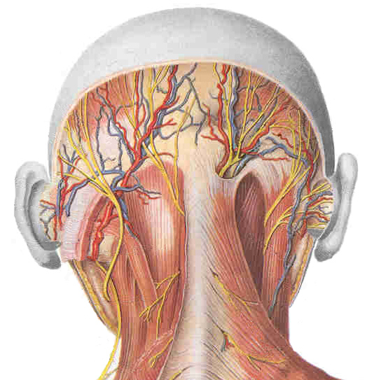
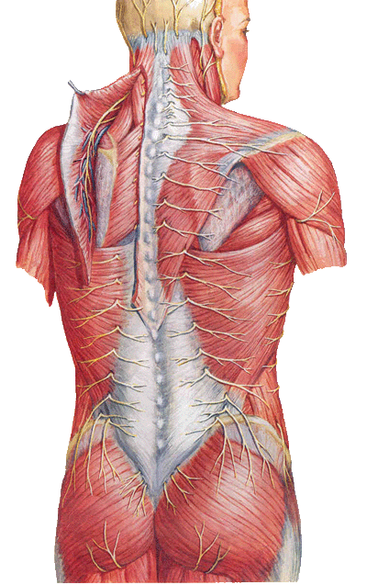
Deep Blood Vessels of Back
Nape region
  Occipital a.
  Dorsal scapular a.
  Vertebral a.
Back region
  Posterior intercostal aa.
  Thoracodosal a.
Lumbar region
  Subcostal a.
  Lumbar aa.
Sacrococcygeal region
  Superior gluteal a.
  Inferior gluteal a.

Slide 14
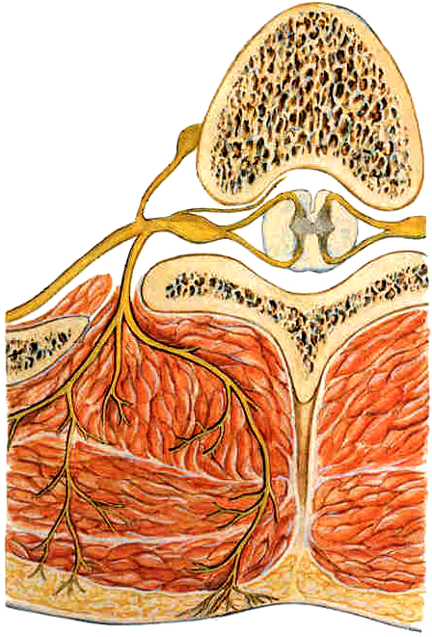
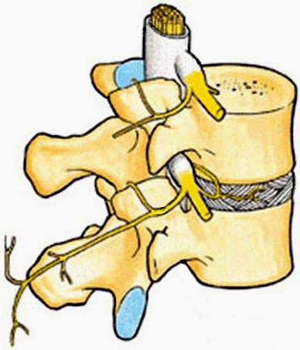
Deep Nerves of Back
Posterior branch of spinal nerve 脊神经后支
  Medial branch
  Lateral branch

Slide 15
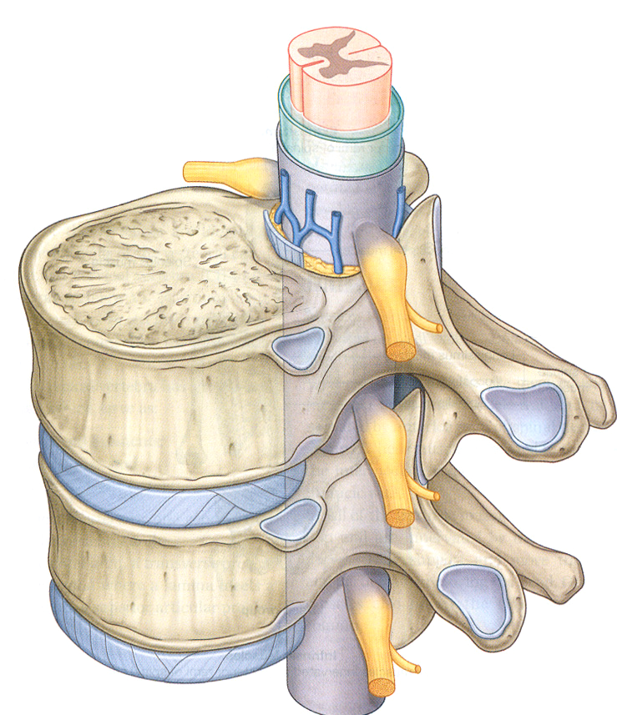
Deep Nerves of Back
Osteofibrous meature 骨纤维孔
Boundaries
  Superolateral: medial border of intertransverse lig. 横突间韧带的内侧缘
  Inferior: superior border of transverse process of vertebra below 下位椎骨横突的上缘
  Medial: lateral border of superior articular process of vertebra below 下位椎骨上关节突的外侧缘
Contents
  Posterior branch of spinal nerve

Slide 16
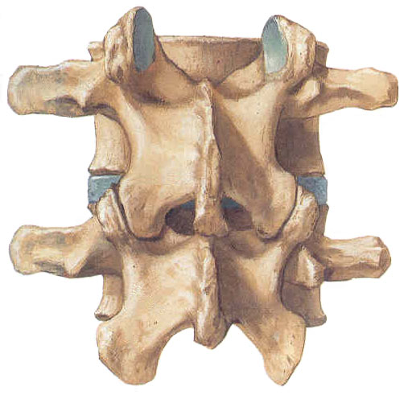
Deep Nerves of Back
Osteofibrous canal 骨纤维管
位于腰椎乳突与副突间的骨沟处
Boundaries
  Anterior wall: 乳突副突间沟
  Posterior wall: 上关节突副突韧带
  Superior wall: mamillary process 乳突
  Inferior wall: accessory process 副突
Contents
  Medial branch of posterior branch of spinal nerve

